Slide 1
British Airways Customer Review Sentiment Analysis
Chase Graham

Slide 2
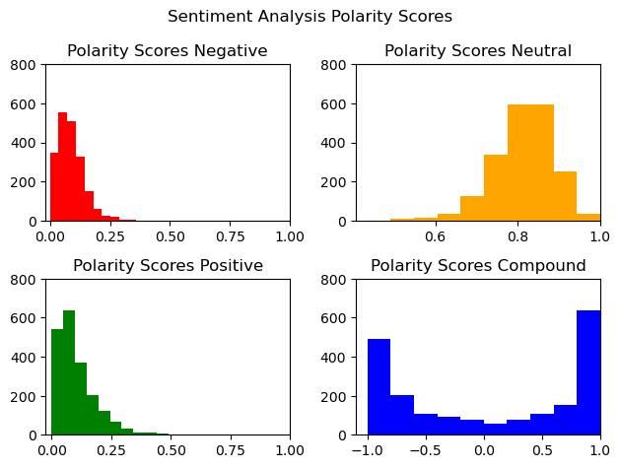
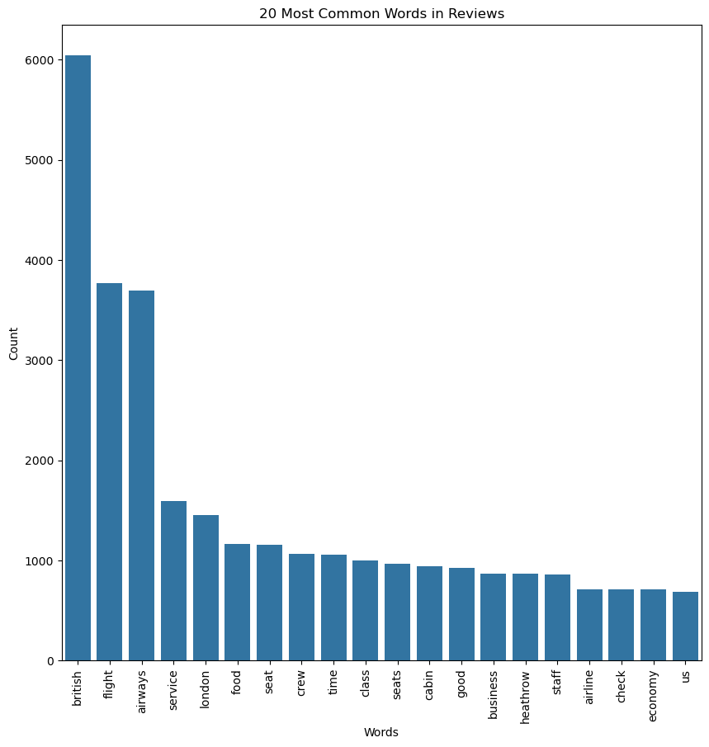
Fig 1. Sentiment Analysis Polarity Scores for 2,000 reviews. The Polarity compound scores show the majority of customers provided highly positive reviews with most reviews falling positive. There is a split nature to the data showing some highly negative reviews as well. Most reviews fall in being 80% neutral language and then the remaining 20% will be either positive or negative.
Fig 2. Bar chart showing the most common words in reviews. Good is the first adjective in the list!

